Slide 1
Servlets

Slide 2
Getting Started with Web Applications
A web application is a dynamic extension of a web or application server. There are two types of web applications:
Presentation-oriented: A presentation-oriented web application generates interactive web pages containing various types of markup language (HTML, XML, and so on) and dynamic content in response to requests
Service-oriented: A service-oriented web application implements the endpoint of a web service

Slide 3
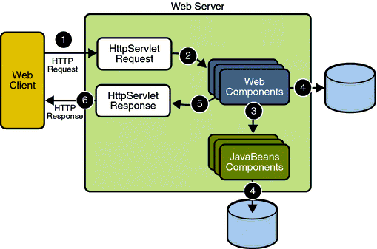
Web Applications

Slide 4
What is a servlet
A servlet is a Java programming language class that is used to extend the capabilities of servers that host applications accessed by means of a request-response programming model.
Java Servlet technology defines HTTP-specific servlet classes.
The javax.servlet and javax.servlet.http packages provide interfaces and classes for writing servlets.

Slide 5
Servlets job
Read explicit data sent by client (form data)
Read implicit data sent by client (request headers)
Generate the results
Send the explicit data back to client (HTML)
Send the implicit data to client
(status codes and response headers)

Slide 6
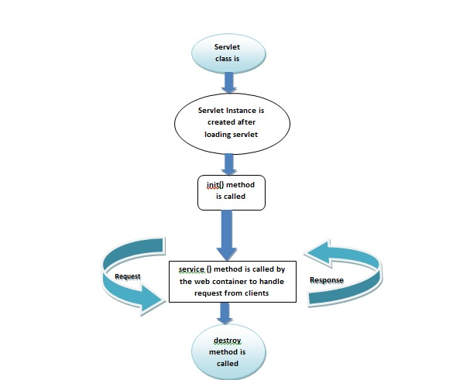
Servlets life cycle

Slide 7
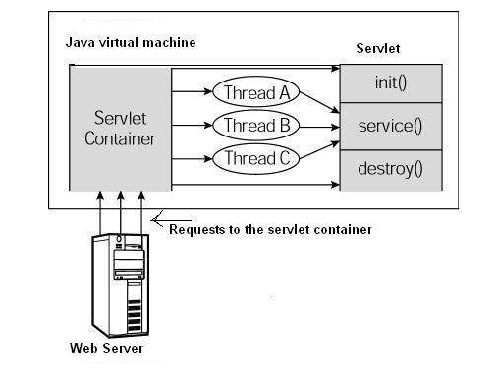
Servlets life cycle

Slide 8
Servlets life cycle
The life cycle of a servlet is controlled by the container in which the servlet has been deployed.
When a request is mapped to a servlet, the container performs the following steps.
If an instance of the servlet does not exist, the web container
Loads the servlet class.
Creates an instance of the servlet class.
Initializes the servlet instance by calling the init method
Invokes the service method, passing request and response objects.
If the container needs to remove the servlet, it finalizes the servlet by calling the servlet’s destroy method.

Slide 9
Main classes
Servlet
ServletConfig
ServletContext
RequestDispatcher
GenericServlet
HttpServlet
ServletRequest
ServletResponse
HttpServletRequest
HttpServletResponse

Slide 10
Example
@WebServlet("/test1")
public class TestServlet extends HttpServlet {
public void doGet(HttpServletRequest request,
HttpServletResponse response) throws
ServletException, IOException {
response.setContentType("text/html");
PrintWriter out = response.getWriter();
out.println
("<!DOCTYPE html>\n" +
"<html>\n" +
"<head><title>A Test Servlet</title></head>\n" +
"<body bgcolor=\"#fdf5e6\">\n" +
"<h1>Test</h1>\n" +
"<p>Simple servlet for testing.</p>\n" +
"</body></html>");
}
}

Slide 11
HttpServlet
The HttpServlet class has methods you can override for each HTTP method (GET, POST etc.). Here is a list of the methods you can override:
doGet()
doPost()
doHead()
doPut()
doDelete()
doOptions()
doTrace()

Slide 12
Web.xml
Deployment Descriptor Elements
With Java EE annotations, the standard web.xml deployment descriptor is optional.
Servlet Mapping
<servlet> <servlet-name>watermelon</servlet-name> <servlet-class>myservlets.watermelon</servlet-class> </servlet>
<servlet-mapping>
<servlet-name>watermelon</servlet-name>
<url-pattern>/fruit/summer/*</url-pattern>
</servlet-mapping>

Slide 13
Web.xml
Filter
<filter>
<filter-name>message</filter-name>
<filter-class>com.acme.filter.MessageFilter</filter-class>
<init-param>
<param-name>message</param-name>
<param-value>A message for you!</param-value>
</init-param>
</filter>
<filter-mapping>
<filter-name>message</filter-name>
<url-pattern>/filter2.jsp</url-pattern>
</filter-mapping>

Slide 14
Web.xml
Listener
<listener>
<listener-class>com.acme.MyConnectionManager</listener-class>
</listener>
<listener>
<listener-class>com.acme.MyLoggingModule</listener-class> </listener>

Slide 15
Handling the Client Request
<!DOCTYPE HTML PUBLIC "-//W3C//DTD HTML 4.0 Transitional//EN">
<HTML>
<HEAD><TITLE>A Sample Form Using GET</TITLE></HEAD>
<BODY BGCOLOR="#FDF5E6">
<H2 ALIGN="CENTER">A Sample Form Using GET</H2>
<FORM ACTION="http://localhost:8088/SomeProgram">
<CENTER>
First name:
<INPUT TYPE="TEXT" NAME="firstName" VALUE="Ivan"><BR>
Last name:
<INPUT TYPE="TEXT" NAME="lastName" VALUE="Ivanov"><P>
<INPUT TYPE="SUBMIT"> <!-- Press this to submit form -->
</CENTER>
</FORM>
</BODY></HTML>

Slide 16
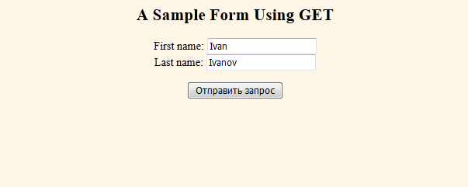
Handling the Client Request

Slide 17
Handling the Client Request
GET /SomeProgram ?firstName=Ivan&lastName=IvanovHTTP/1.1
User-Agent: Mozilla/5.0 (Windows NT 6.1; rv:41.0) Gecko/20100101 Firefox/41.0
Referer: http://localhost:8088/SomeProgram/index.html
Host: localhost
Connection: keep-alive
Accept-Language: ru-RU,ru;q=0.8,en-US;q=0.5,en;q=0.3
Accept-Encoding: gzip, deflate
Accept: text/html,application/xhtml+xml,application/xml;q=0.9,*/*;q=0.8

Slide 18
Handling the Client Request
<!DOCTYPE HTML PUBLIC "-//W3C//DTD HTML 4.0 Transitional//EN">
<HTML>
<HEAD><TITLE>A Sample Form Using GET</TITLE></HEAD>
<BODY BGCOLOR="#FDF5E6">
<H2 ALIGN="CENTER">A Sample Form Using POST</H2>
<FORM ACTION="http://localhost:8088/SomeProgram" METHOD="POST">
<CENTER>
First name:
<INPUT TYPE="TEXT" NAME="firstName" VALUE="Ivan"><BR>
Last name:
<INPUT TYPE="TEXT" NAME="lastName" VALUE="Ivanov"><P>
<INPUT TYPE="SUBMIT"> <!-- Press this to submit form -->
</CENTER>
</FORM>
</BODY></HTML>

Slide 19
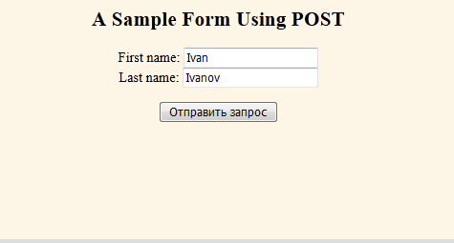
Handling the Client Request

Slide 20
Handling the Client Request
POST /SomeProgram HTTP/1.1
User-Agent: Mozilla/5.0 (Windows NT 6.1; rv:41.0) Gecko/20100101 Firefox/41.0
Referer: http://localhost:8088/SomeProgram/index.html
Host: localhost:8088
Connection: keep-alive
Accept-Language: ru-RU,ru;q=0.8,en-US;q=0.5,en;q=0.3
Accept-Encoding: gzip, deflate
Accept: text/html,application/xhtml+xml,application/xml;q=0.9,*/*;q=0.8
firstName=Ivan&lastName=Ivanov

Slide 21
Get vs Post
• Advantages of POST
– URL is simpler
– Data is hidden from people looking over your shoulder
– Larger amounts of data can be sent
– Can send special characters (e.g., in uploaded files)
– Browsers will not cache results
– Should always be used if the requests changes data on
server (REST)
• Advantages of GET
– Can bookmark results page
– Browsers can cache results
– Easier to test interactively

Slide 22
Reading Form Data In Servlets
• request.getParameter("name")
– Returns URL-decoded value of first occurrence of name
in query string
– Works identically for GET and POST requests
– Returns null if no such parameter is in query data
• request.getParameterValues("name")
– Returns an array of the URL-decoded values of all
occurrences of name in query string
– Returns a one-element array if param not repeated
– Returns null if no such parameter is in query
• request.getParameterNames() or
request.getParameterMap()
– Returns Enumeration or Map of request params
– Usually reserved for debugging

Slide 23
Example
Expression expression = new Expression(); expression.setFirstOperand(req.getParameter("val1")); expression.setSecondOperand(req.getParameter("val2")); expression.setOperationName(req.getParameter("operationName"));

Slide 24
HttpServletRequest
• General
– getHeader (header name is not case sensitive)
– getHeaders
– getHeaderNames
• Specialized
– getCookies
– getAuthType and getRemoteUser
– getContentLength
– getContentType
– getDateHeader
– getIntHeader
• Related info
– getMethod, getRequestURI , getQueryString, getProtocol

Slide 25
HTTP Request/Response
• Request
GET /servlet/SomeName HTTP/1.1
Host: ...
Header2: ...
...
HeaderN:
(Blank Line)
Response
HTTP/1.1 200 OK
Content-Type: text/html
Header2: ...
...
HeaderN: ...
(Blank Line)
<!DOCTYPE ...>
<HTML>
<HEAD>...</HEAD>
<BODY>
...
</BODY></HTML>

Slide 26
Setting Status Codes
• response.setStatus(int statusCode)
– Use a constant for the code, not an explicit int.
Constants are in HttpServletResponse
– Names derived from standard message.
E.g., SC_OK, SC_NOT_FOUND, etc.
• response.sendError(int code, String message)
– Wraps message inside small HTML document
• response.sendRedirect(String url)
– Sets status code to 302
– Sets Location response header also

Slide 27
Common HTTP 1.1 Status Codes
• 200 (OK)
– Everything is fine; document follows.
– Default for servlets.
• 204 (No Content)
– Browser should keep displaying previous document.
• 301 (Moved Permanently)
– Requested document permanently moved elsewhere
(indicated in Location header).
– Browsers go to new location automatically.
– Browsers are technically supposed to follow 301 and 302
(next page) requests only when the incoming request is
GET, but do it for POST with 303. Either way, the
Location URL is retrieved with GET.

Slide 28
Common HTTP 1.1 Status Codes
• 302 (Found)
– Requested document temporarily moved elsewhere
(indicated in Location header).
– Browsers go to new location automatically.
– Servlets should use sendRedirect, not setStatus, when
setting this header. See example.
• 401 (Unauthorized)
– Browser tried to access password-protected page without
proper Authorization header.
• 404 (Not Found)
– No such page. Servlets should use sendError to set this.
– Problem: Internet Explorer and small (< 512 bytes) error
pages. IE ignores small error page by default.
– Fun and games: http://www.plinko.net/404/

Slide 29
A Servlet That Redirects Users
@WebServlet("/redirect") public class Redirect extends HttpServlet { public void doGet(HttpServletRequest request, HttpServletResponse response) throws ServletException, IOException { String userAgent = request.getHeader("User-Agent"); if ((userAgent != null) && (userAgent.contains("MSIE"))) { response.sendRedirect("http://home.mozilla.com"); } else { response.sendRedirect("http://www.microsoft.com"); } } }

Slide 30
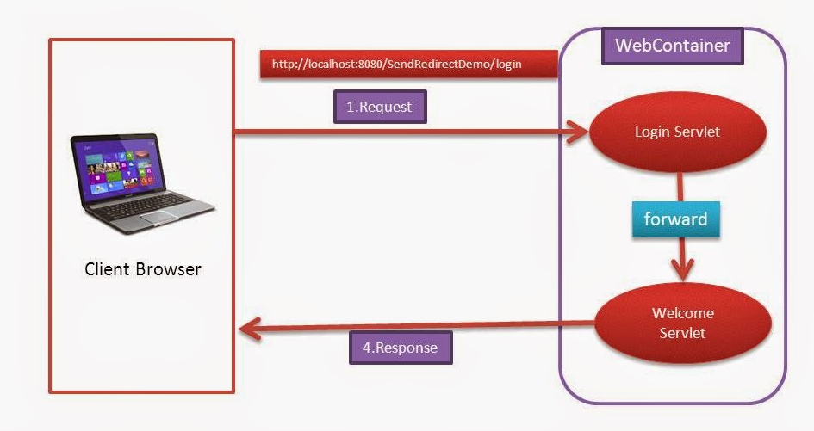
Forward

Slide 31
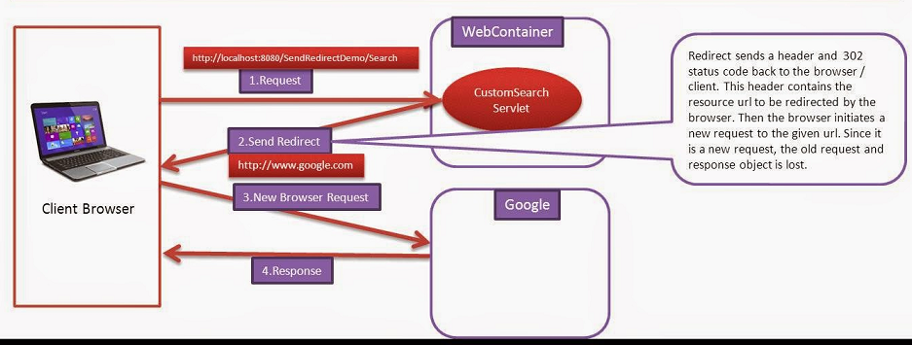
SendRedirect

Slide 32
Setting Arbitrary Response Headers
• response.setHeader(String headerName,
String headerValue)
– Sets an arbitrary header
• response.setDateHeader(String name,
long millisecs)
– Converts milliseconds since 1970 to a date string
in GMT format
• response.setIntHeader(String name,
int headerValue)
– Prevents need to convert int to String before calling
setHeader
• addHeader, addDateHeader, addIntHeader
– Adds new occurrence of header instead of replacing

Slide 33
Common MIME Types
application/msword
application/octet-stream
application/pdf
application/postscript
application/vnd.ms-excel
application/vnd.ms-powerpoint
application/x-gzip application/x-java-archive
application/x-java-vm
application/zip
audio/basic
audio/x-aiff
audio/x-wav
audio/midi
text/css
text/html
text/plain
text/xml
image/gif
image/jpeg
image/png
image/tiff
video/mpeg
video/quicktime

Slide 34


Slide 35
Задание
Реализовать web-application. Использовать Jsp , maven. С использованием EasyMock и TestNG покрыть код тестами. Создать две группы тестов: 1) success path 2) scenarios that must fail. Настроить parallel run.
1) Реализовать регистрацию пользователей сайта
- Реализовать валидацию данных пользователя на стороне
клиента и на стороне сервера
- На стороне сервера выполнить проверку на существование
пользователя с введенным логином.
- Пока что не используем базу данных, а храним пользователей
в памяти.
2) Сделать так, чтобы при ошибке клиенту не надо было заново вводить всю регистрационную информацию.
- В качестве регистрационной информации надо использовать
как минимум: имя, фамилия пользователя, пароль, повторный
пароль, адрес электронной почты, логин name, пол.
3) Если пользователь успешно залогинился перебрасывать его на страничку с приветствием. Иван Сидоров, вы успешно зарегистрировались
4) Реализовать Login form. При успешной авторизации перебрасывать его на страничку с приветствием.

